Slide 1
What is Lent?
R.C.I.A.
Immaculate Heart of Mary Parish
Deacon Greg Meier

Slide 2
What Is Lent?
What do you think of when you hear the word “lent”?

Slide 3
What Is Lent?
What do you think of when you hear the word “lent”?
Other faith traditions?

Slide 4
What Is Lent?
What do you think of when you hear the word “lent”?
Other faith traditions?
Memories of Lent?

Slide 5
Goals
Answer the question: What is Lent?
Scriptural sources for the season
History of Lent
Discuss “3 pillars” of Lent
Describe some Catholic Practices during Lent
Starting your plan of action

Slide 6
Operational Definition of Lent
Liturgical season, 40 days preceding Easter
Springtime
Notes:
The word LENT comes from the Old English word meaning lengthen of days. After the Winter Solstice, our daylight hours are getting longer as we race toward the Spring Equinox.
The liturgical season of 40 days which begins on Ash Wednesday and ends with the celebration of the Paschal Mystery (Easter Triduum). Lent is the primary penitential season in the Church’s liturgical year, reflecting the forty days Jesus spent in the desert in fasting and prayer.
2 natures of Lent
Traditionally time for catechumens to prepare for baptism
All are called to reflect and to evaluate how they are living out their baptismal promises
All are called to examine our life; are we ready for the coming of the bridegroom? If not, what do we have to do to get ready?

Slide 7
Operational Definition of Lent
Liturgical season, 40 days preceding Easter
Springtime
Baptismal Nature
Penitential Nature
Notes:
The liturgical season of 40 days which begins on Ash Wednesday and ends with the celebration of the Paschal Mystery (Easter Triduum). Lent is the primary penitential season in the Church’s liturgical year, reflecting the forty days Jesus spent in the desert in fasting and prayer.
2 natures of Lent
Traditionally time for catechumens to prepare for baptism
All are called to reflect and to evaluate how they are living out their baptismal promises
All are called to examine our life; are we ready for the coming of the bridegroom? If not, what do we have to do to get ready?

Slide 8
Scriptural Sources
The number “40”
  Great Flood: Gn 7:4, 12,17,*:6)
  Moses: Ex 24:18
  Scout Promised Land: Nm 13:25
  Elijah: 1 Kgs 19:8
  Temptation of Jesus: Matt 4:1-11
  Resurrection: Acts 1:3
Notes:
Numbers in the Bible not taken literally, always symbolic: 3 meanings
1) Generation, fullness, completion
2) But also, this longer period of time has content, it is a time of need, of struggle, of testing.
Forty denotes a period of preparation for some special action of the Lord, it is a time of grace.
After flood, a new creation :blessing of baptismal water at baptism: The waters of the great flood you made a sign of the waters of baptism, which bring an end to sin and a new beginning to goodness.
After each period, there was a strengthening

Slide 9
Time and Place
Wilderness
  Abode of dangerous animals
  Desert a place of extremes, choices more clear cut
  A negative place, little rain, and vegetation
Experience
  Spiritual retreat, set time apart to focus, ask,
  To consider, to respond
Notes:
Just as the length of time is more or less symbolic, the place is also.
Desert a dangerous place
Gospels tell of Jesus going to the desert to face temptation to pleasure, power, and fame.
Satisfy physical needs (turn stone into bread); manifest authority (all this will be yours) make demands on God to become famous (throw yourself down).
Lent is the Church’s wilderness, desert experience; a time set apart to focus on the basic questions; do you reject satan? And all his works?

Slide 10
Journey
Israel's time in wilderness not aimless wandering…a beginning and an end; a goal
Temptations to stop and settle
Temptation to idolatry; past is secure, holds no surprises (we’ve been there)
Transfiguration story…let us build tents
Notes:
Remember that the Israeli people were complainers. To Moses, why did you bring us out of Egypt, we enjoyed being slaves, the hard work, the torture, that was nothing compared to this desert. Exodus 16:2-3
A danger of nostalgia; to hold onto the past so much so you do not have to face the future.
A time of purging, changing attitudes

Slide 11
Journey in Desert
A place of covenant (at Mt. Sinai)
A period of “attitude adjustment”
A place of faith testing
A place of presence
Notes:
Come to Sinai to learn how to worship Yahweh
Covenant at Ex 19 keep my commands, you will be a holy nation
Turn from slaves to free people; to avoid historical fact that oppressed set free become oppressors.
New set of values, a new way of life
Desert of Sin Ex 16
No food, God sends manna
No water, God gives water from rock
Enemies threaten, God delivers them. God is present for them, for us.
Israelis often failed their tests of faith. Unlike Jesus in the desert, where he remained faithful to God. What about us? We all face every day temptations, tests of our faith, how do we/will we respond? Lent is about reflecting on this question and its answer in our lives.

Slide 12
Lent then….
Lent is a wilderness experience for us
Springtime, new life after winter
A time of repentance and renewal
A time of more intense prayer
Looks forward to Easter
With total dependence and trust in God, we will persevere

Slide 13
When did Lent begin?
3 sources merged early 4th century
  Ancient paschal fast that began as 2 day fast before Easter, but gradually increased to 40 days
  Catechumenate process for preparation for baptism
  Order of Penitents, seeking 2d conversion
Notes:
MOVE FAST THROUGH THESE HX SLIDES
First Christians always celebrated Easter on the Day of the Lord’s Resurrection (Sunday)
Time of persecutions, demanding catechumenate period, sponsors verified
Preparation for making/renewing baptismal promises at Easter

Slide 14
Origins of Lent, con’t
Period of fasting for 40 days began in Rome about 354 AD
“Ash” Wednesday added to get the full 40 days of fasting (Sundays were non-fast days) (about 500 AD)
About 780-800 use of ashes begun; a practice long in use but now given a liturgical connotation

Slide 15
Origins of Lent, con’t
Ashes
  Summon to communal penance (Joel 2:12-18)
  St Paul’s appeal to be reconciled (2 Cor 5:20_
  Jesus’ call to alms, prayer, and fast (Matt 6:1-18)
Genesis 3:19: Remember, man, you are dust and to dust you will return
Mark 1:15: Turn away from sin and be faithful to the gospel
Call to conversion
Notes:
Ashes are an ancient symbol of repentance
Reminder of our death
A symbol: how we live our lives does, in fact, matter.
Jesus says Mark 1:15 Repent and believe in the Gospel

Slide 16
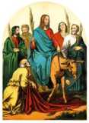
Origins of Lent, con’t
Palm Sunday: Holy Week
  In Jerusalem @ 500 AD
  Celebrate Jesus’ entry into Jerusalem
Passion Sunday
  In Rome @ 440-461 AD
  Passion Gospel narratives read at Mass
Palm branches and acclamation in both; universal by 9th century

Slide 17
Origins of Lent, con’t
Blessing of the Holy Oils
  Holy Thursday
  Not until 1955 that a special “chrismal Mass” adopted in Roman rite
Absolution Thursday
  Holy Thursday was day of reconciliation for all penitents since 4th century

Slide 18
Mass Readings of Lent
Old Testament readings recall the events of salvation history
2nd Readings chosen to shed light on others
Gospels:
Temptation
Transfiguration
Samaritan Woman At The Well
Blind Man Cured
Raising Of Lazarus
Entry To Jerusalem, Passion
Notes:
Readings for Year A….should be used during the RCIA Rite Masses

Slide 19
Prefaces of Lent
All special to Lent
Ancient texts

Slide 20
3 Pillars of Lent
PRAYER
FASTING
ALMSGIVING
Notes:
Goal of all 3 is to live out our Baptismal promises: witness to Christ in the world
It is to be affective: formative and changing our hearts

Slide 21
PRAYER
Unite ourselves to the mystery of Jesus in the desert
Reflect on history of salvation
Spiritual exercises
Put yourself in touch with God!
Notes:
LISTEN
Pray for strength to make the changes in our lives that our reflection tells us are necessary

Slide 22
FASTING
Self-denial
Penitential acts such as liturgies, reconciliation, and fraternal service such as charitable or mission works
And of course, food
Notes:
Fasting predates lent: the Paschal fast, 2 days later 40 days before Easter
See Isaiah 58: 6-7
Fasting is an ancient tradition.
Historian writes at beginning of 5th century of fast/abstain from meat; some ate only fish, some birds also since the birds sprang from the waters in the creation stories. Some abstain from all forms of meat, including foods derived from animals (milk, eggs, cheese). Hence tradition of giving eggs on Easter.
Fasting exercises self-control—stands opposite of self-indulgence.
Fasting can also be done for solidarity—to feel the pain that poor people suffer who lack access to food. Makes us more appreciate the abundance of food in our culture for most of us.
Abstaining from meat links us spiritually to less fortunate, a form of a fast; it is a sacrifice especially in the US where meat is so abundant and part of our daily life.

Slide 23
ALMSGIVING
Acts of charity and generosity
Give of yourself!
Give your heart, your kindness, your real self
More than just money or cleaning out closets

Slide 24
Practices during Lent
Calendar: Sundays of Lent have precedence over feasts/solemnities
  Weekdays of Lent over obligatory memorials
Reconciliation / penance lead toward conversion of heart
Few, if any, church decorations
Music only when necessary
Notes:
Liturgical color is purple

Slide 25
Practices, con’t
“Gloria” and “Alleluia” not used in Mass
Devotional exercises encouraged
Reception of ashes
Fast and abstinence
  Ash Wednesday, Good Fridays
  Abstinence all Fridays of Lent
Crosses and images covered

Slide 26
Devotions and Practices, con’t
Stations of the Cross
Novenas
“Mission” speakers
All encouraged to attend daily Mass

Slide 27
R.C.I.A. Practices
Rite of Election
  Bishop leads rite publicly announcing those who are chosen (elected) to soon receive the sacraments of initiation
Scrutinies
  Special communal prayers designed to help participants closely examine their lives, mindsets and attitudes. What comes between you and God? A value check.

Slide 28
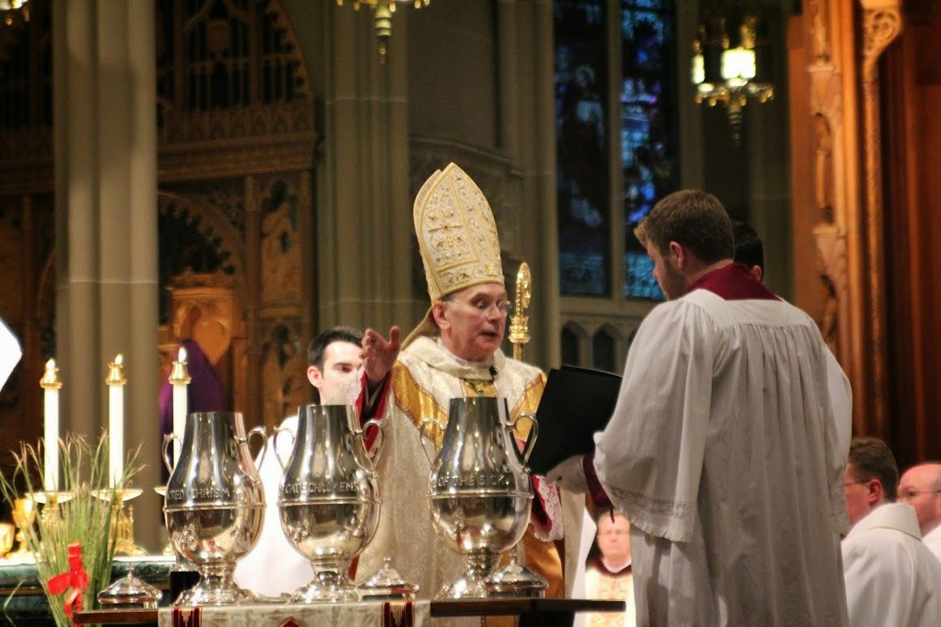
Chrism Mass
During “Holy Week”
Bishop presides
Presentation, mixing, and blessing of Holy Oils used throughout the diocese all year long
Reception of the oils by the parishes and institutions

Slide 29
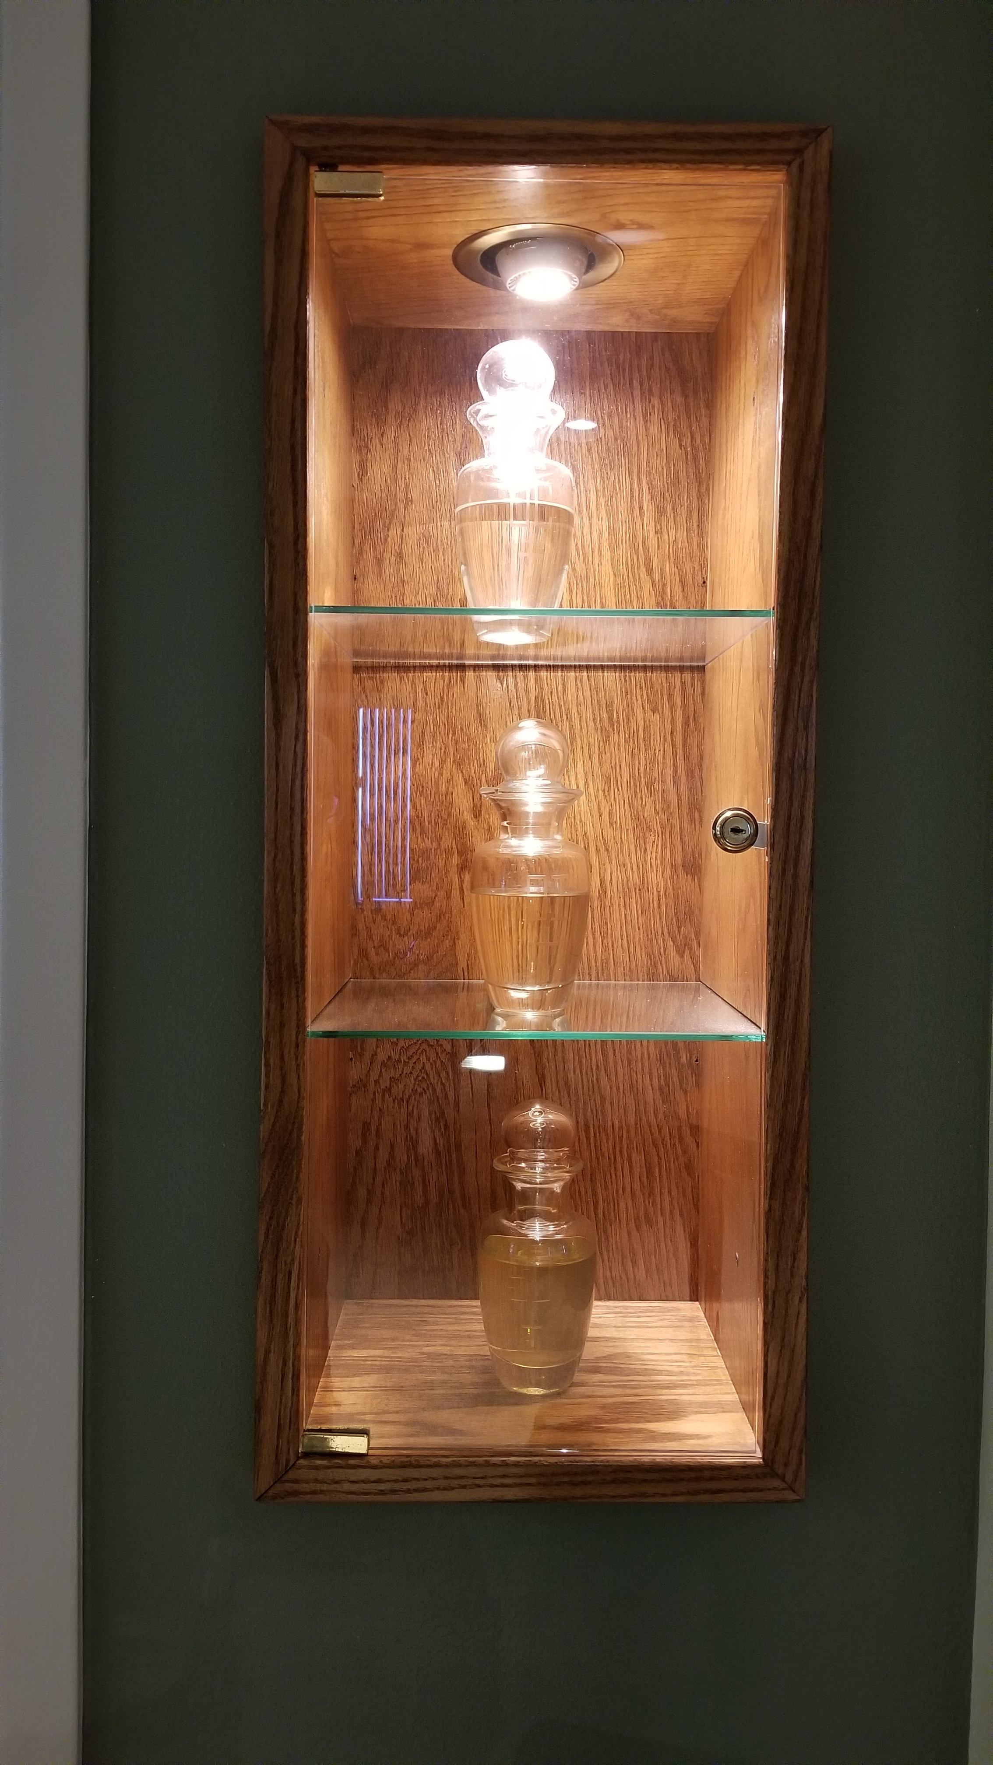
Sacred Oils
OI Oil of the Infirmed (Anointing of the Sick)
Oil of Catechumens (Anointing at Baptism—strengthening against powers of the devil)
Sacred Chrism (Confirmation and Baptism—perfumed oil—Holy Spirit)

Slide 30
Lenten season ends with celebration of the Mass of the Lord’s Supper on Holy Thursday—which begins the Easter Triduum

Slide 31
In Summary
Lent has solid scriptural basis
Two characteristics are baptism and penance
Ancient liturgical practices merge beginning in 4th century
Journey toward Easter marked by intense prayer and spiritual practices aimed toward conversion of heart and baptismal promises

Slide 32
Plan of Action
Lent is a marathon….not a sprint
Spiritual couch potato?
  Bare minimum
    Fast on Ash Wed. and Good Friday
    Abstain from meat on Fridays
    Sacrament of Reconciliation

Slide 33
Plan of Action
Spiritual Jogger
  Add to the basics
    Fast from personal pleasures
      Food, TV, social media…
    Liturgical Devotions
      Station of the Cross (Fri)
      Weekday Mass
      Corporal/Spiritual Works of Mercy

Slide 34
Plan of Action
Spiritual Marathoner
  Bigger Challenge in fasting
    One day of bread and water only
  Daily devotional
    Daily Rosary
    Liturgy of the Hours (Morning/Evening Prayer)

Slide 35
3 DAYS
The Easter Triduum

Slide 36

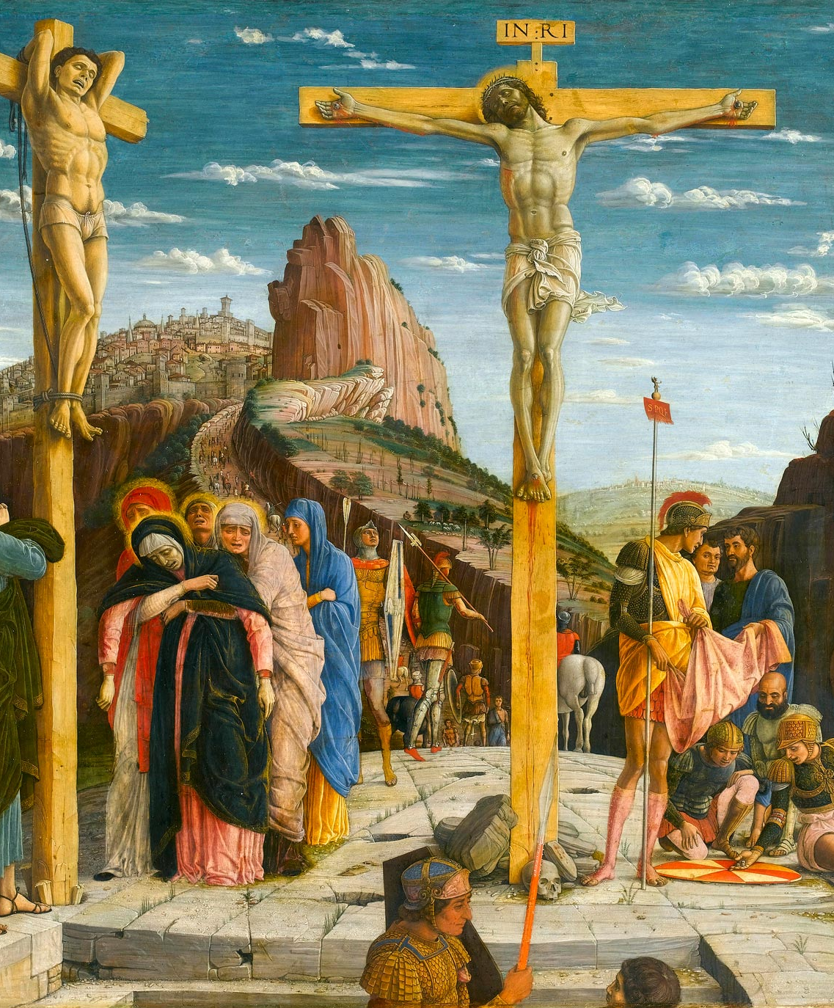
Palm Sunday: Holy Week
Palm Sunday
Chrism Mass
Mass of the Lord’s Supper
The Lord’s Passion
Easter Vigil
Resurrection of the Lord

Slide 37
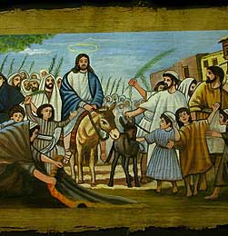
Palm Sunday ---→Passion Sunday
Triumphant Entry into Jerusalem
People shouting Hosanna!
Palm Branches
Same People will call on Pilate to Crucify Jesus
Customary to take the blessed palm branches home

Slide 38
Chrism Mass
Two movements:
  Rededication of all the priests of our Diocese
  Blessing and Distribution of Sacred Oils to the Diocese
Presentation of the Oils
Blessing and Mixing of the Oils
Procession of the Parishes and Institutions of the Diocese
Reception of the Sacred Oils from the Bishop to the Parish

Slide 39
Sacred Oils
OC: Oil of Catechumens
OI: Oil of the Infirmed
SC: Sacred Chrism

Slide 40
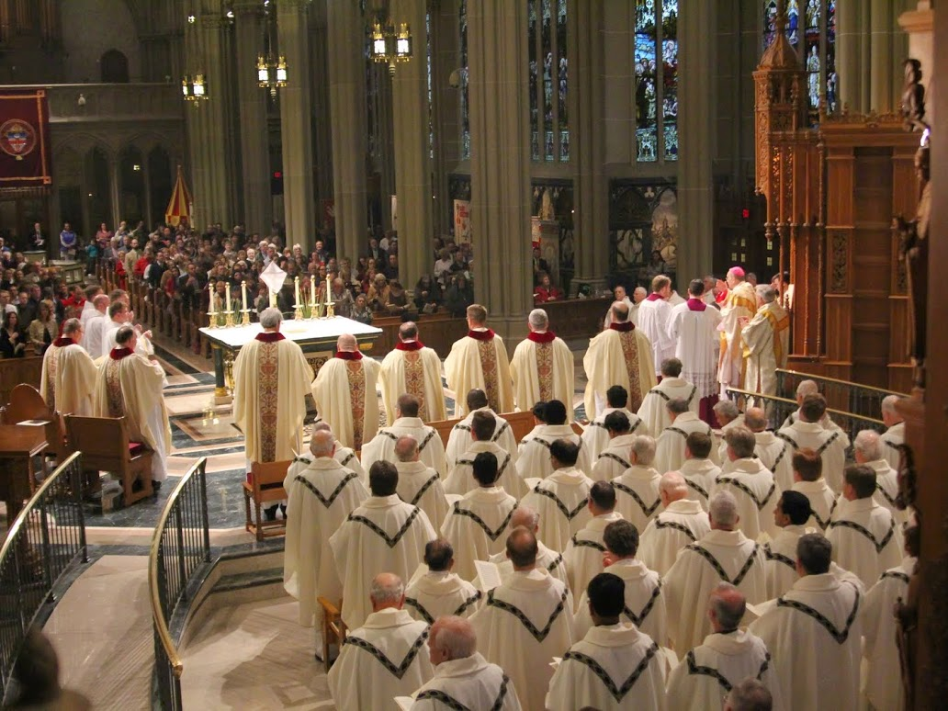

Slide 41
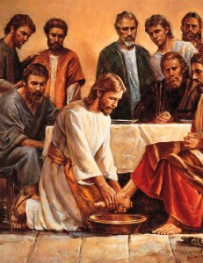
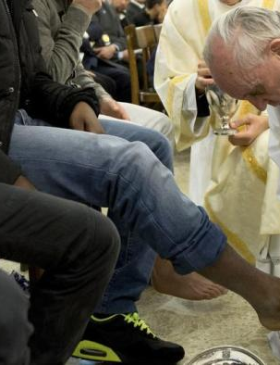
Holy Thursday of the Lord’s Supper
Lent ends; Sacred Triduum begins
Mass of the Lord’s Supper
Washing of the Feet
No Dismissal like usual at Mass
Eucharistic Procession
Adoration in special reserved space
All depart in silence

Slide 42
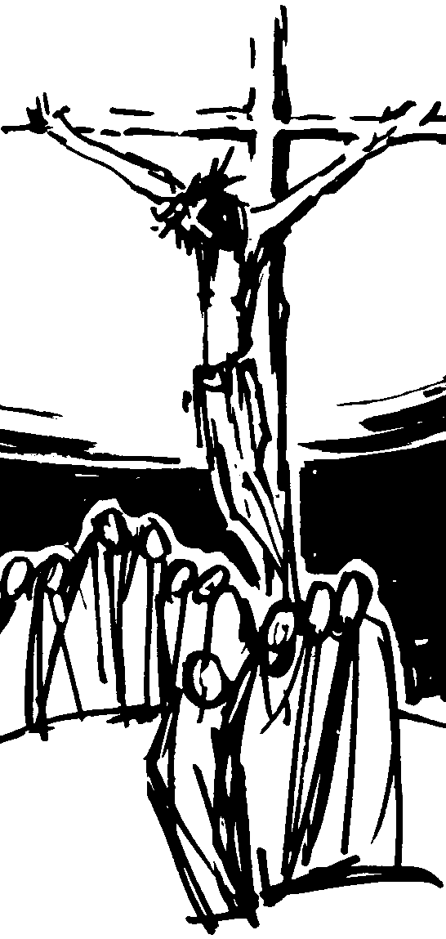
Good Friday (of the Passion of the Lord)
Entrance in silence
No Mass today—a continuation of the 3 days
Reading of the Passion Narrative
Special Prayers of Intercession
Unveiling and veneration of the cross
Holy Communion
All depart in silence

Slide 43
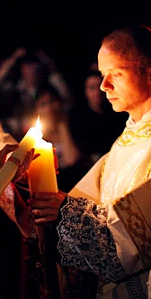
Easter Vigil (Holy Saturday)
Service of Light
  Blessing of new fire and Paschal Candle
  Chanting of the Exsultet (Easter Proclamation)
  Light grows from Paschal Candle
Vigil Readings of Salvation History
Joyous music and bells return to Mass
Celebration of the Sacraments of Initiation
Alleluia (double at dismissal) returns

Slide 44
Easter Sunday
Renewal of Baptismal Promises
Joyful praise
Triduum ends
Easter Season begins: 50 days of joyful praise
Pentecost ends Easter Season

